Slide 1
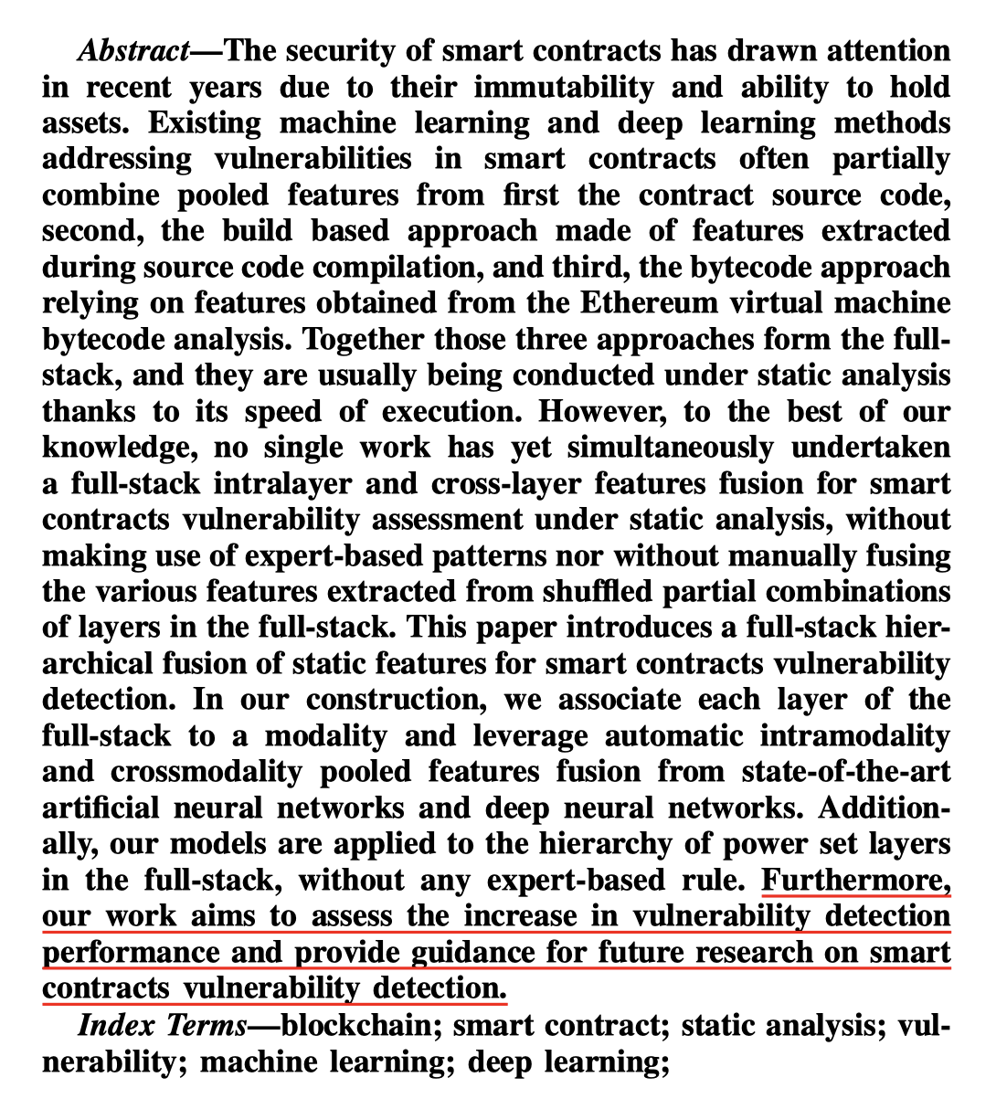
Question 1:
The content of the abstract should clearly describe the results of the study. It would be great if the author could write a sentence to describe the numerical result.
Rebuttal:
A1: Thank you for your advice. We add “In the dataset consisting of 20,601 smart contracts, our method achieves 94.5% accuracy, with 15.6% improvements compared to the expert knowledge-based method.” in Abstract.

Slide 2
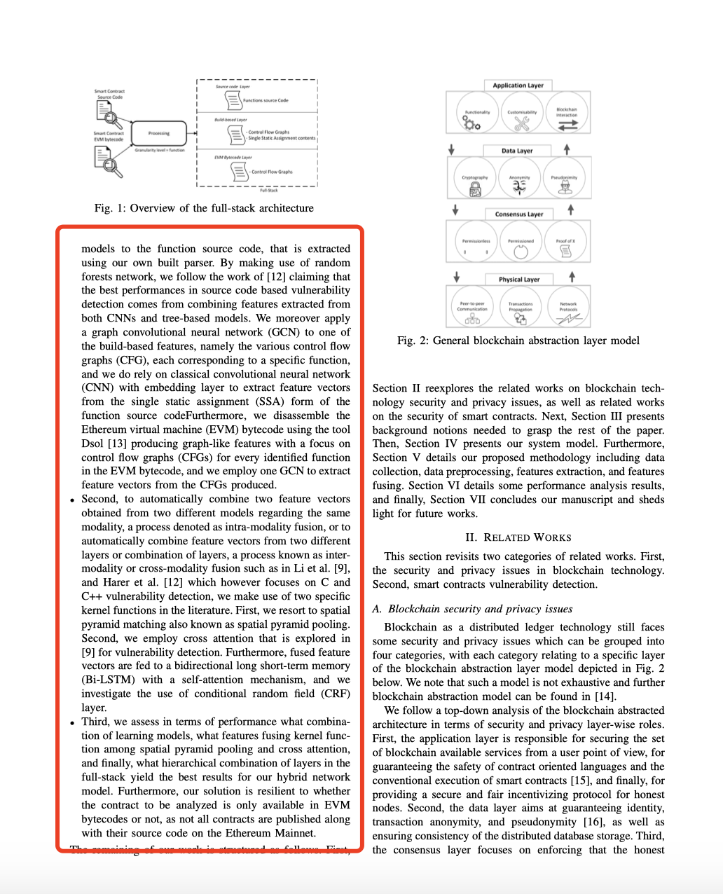
Question 2:
The article lists three contributions. However, each contribution is described in so much detail that the point of innovation is not clear enough. It is suggested that the authors briefly summarize it.
Rebuttal:
Many thanks for your suggestion. We reorganize the contributions as follows:
“
Our scheme brings in the following innovations:
•To the best of our knowledge, we are the first to simultaneously undertaken a full-stack intralayer and cross-layer features fusion for smart contracts vulnerability assessment under static analysis, without any expert-based patterns.
•We introduce a full-stack hierarchical fusion of static features, where each layer is associated to a modality and intramodality and cross-modality pooled features are automatically fused from state-of-the-art deep neural networks.
•We publish a large smart contraction detection dataset consisting of 20,601 smart contractions. Extensive experiments are conducted on this dataset to validate the effectiveness of our method.
”

Slide 3
Question 3:
Detecting vulnerabilities is an important topic, this work needs to analyze the existing work.
Rebuttal:
We add more discussion of recent paper and present the differences with our paper in the Related Work Section.
In summary, 1) the existing work does not simultaneously exploit the source code-based approach, the bytecode-based approach and the build-based approach; 2) the existing work are highly relying on expert-based rules and manual features fusion.
Question4:
The problem should be verified experimentally and precisely, not by uncertain conjectures.
Rebuttal:
Thank you for your suggestion.
We conducted the experiments on different solidity compiler and have verified the compilation errors are caused by the different compiler version.
Thus, we change this sentence to “ By the extensive experimental verification, those compilation errors are due to the differences between the more advanced version of the solidity compiler used on the deployed and verified contracts, and the version of the solidity compiler implemented in our tools.”

Slide 4
Question5:
Whether there is a more accurate way to classify labels.
Rebuttal:
No. So far, Slither Static Analysis Tool is the state-of-the-art smart contract vulnerability detection tool and is adopted in many related work [1,2,3].
[1] Xue Y, Ye J, Zhang W, et al. xFuzz: Machine Learning Guided Cross-Contract Fuzzing[J]. IEEE Transactions on Dependable and Secure Computing, 2022.
[2] Wu H, Zhang Z, Wang S, et al. Peculiar: Smart contract vulnerability detection based on crucial data flow graph and pre-training techniques[C]//2021 IEEE 32nd International Symposium on Software Reliability Engineering (ISSRE). IEEE, 2021: 378-389.
[3] Li B, Pan Z, Hu T. ReDefender: Detecting Reentrancy Vulnerabilities in Smart Contracts Automatically[J]. IEEE Transactions on Reliability, 2022.

Slide 5
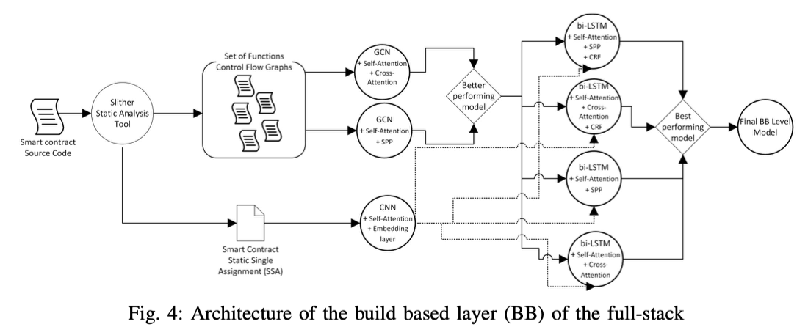
Question6:
Writing issues.
Rebuttal：
Thank you for pointing out the writing issues. We go through the whole manuscript carefully to make necessary revisions for improving the readability.
(1) We enlarge the figures and change the font to Times New Rome.
(2) The references are polished carefully.
(3) The typos and grammar mistakes are fixed.

